Slide 1
USDN Emergent Learning Fund
Mobilizing Youth To Promote Hurricane Preparedness Throughout Vulnerable Communities
City of Savannah

Slide 2
Background
In July 2024, the City of Savannah was awarded a $15,000 grant from the USDN Emergent Learning Fund to engage youth and volunteers in distributing hurricane preparedness bags in vulnerable, historically overlooked neighborhoods. This initiative aimed to strengthen community resilience and ensure that these areas are better equipped to handle future disasters. This project was implemented in close collaboration with local non-profit Savannah Youth City.
Primary project focus.
Capacity and partnership building around specific initiatives.
2. Primary short-term output.
A general increase in community ownership in climate work.
3. Primary long-term outcome.
There is greater alignment across sectors to address climate change.

Slide 3
Project Leads
City of Savannah Office of Sustainability
Savannah Youth City
The City of Savannah's Office of Sustainability is dedicated to fostering environmental, social, and economic sustainability throughout the community. It works to implement policies and initiatives that promote sustainable practices, address climate change, and improve the quality of life for residents.Through programs focused on sustainability education, resilience planning, and climate adaptation, the Office of Sustainability seeks to build a more resilient and equitable Savannah for future generations.
Since 2017, Savannah Youth City has been offering Community Emergency Response Team (CERT) training to youth during the summer months. Through this initiative, Savannah Youth City has trained both youth and adult volunteers to canvas marginalized neighborhoods and to distribute crucial hurricane preparedness tools and resources. This hands-on experience helps participants develop a deeper understanding of community engagement while strengthening resilience in underserved areas.

Slide 4
Official Partners
Chatham Emergency Response Agency
City of Savannah
Police Department
Harambee House/
Citizens For Environmental Justice

Slide 5
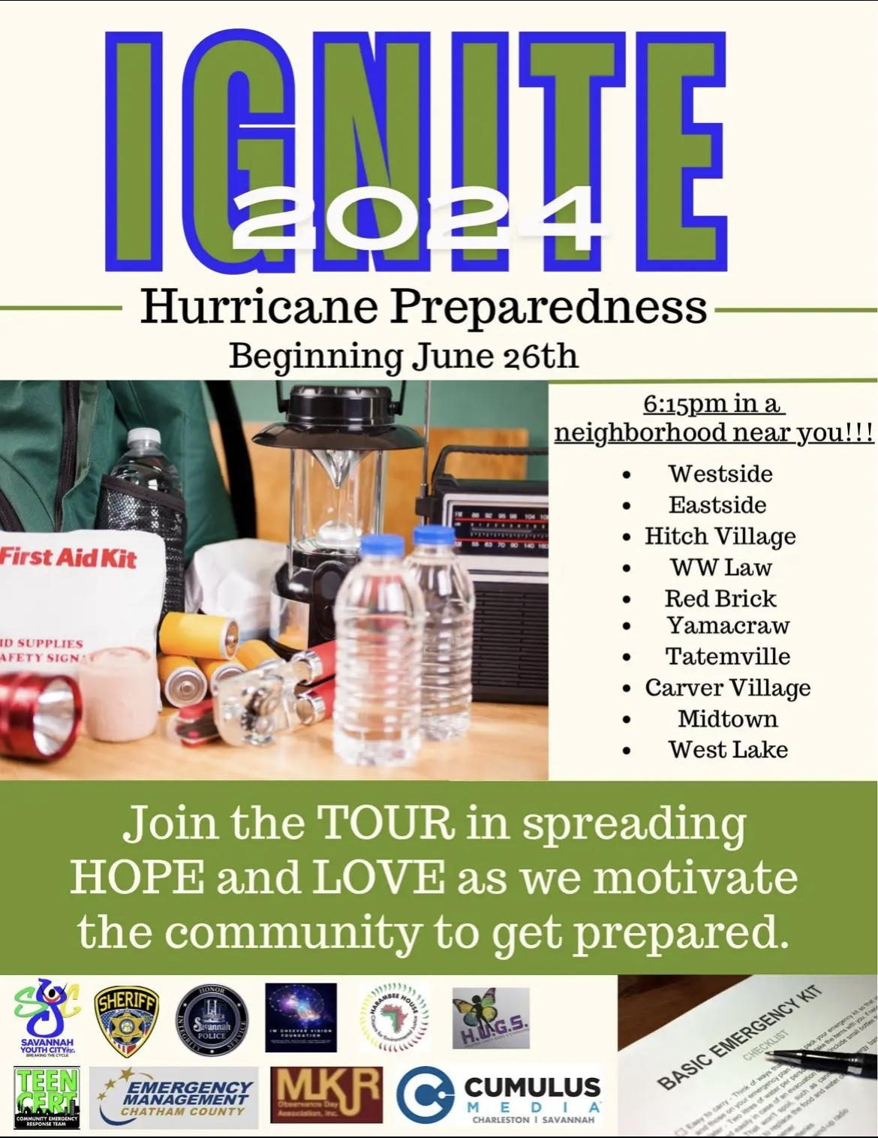
Influencing Change and Innovation
A key aspect of this program was to foster a sense of community and make residents feel comfortable and engaged. Instead of instructing youth to go door-to-door, our goal was to create a fun, welcoming environment that encourages participation. When addressing topics like climate change and disaster preparedness, it's crucial to uplift and empower individuals, rather than instill fear or anxiety. To achieve this, we provided music, food, and beverages to create an inviting atmosphere and encourage people to join in. By using this approach, we were able to engage community members who would typically be uninterested in hurricane preparedness, ensuring they are now informed, prepared, and equipped to respond in the event of an emergency.

Slide 6
Timeline
Start marketing and finalize project partners
Start neighborhood engagement
End neighborhood engagement
Train youth and volunteers
Evaluate first half of visits
This project was implemented from early June – October. Hurricanes have typically affected the metro-Savannah area during the latter portion of these months.

Slide 7
First Five Neighborhood Engagements
Westside
Eastside
Thunderbolt*
Majority African-American Community
Majority African-American Community
Bonus Visit Funded by the City of Thunderbolt!
Frazier Homes
W.W. Law
Red Brick
Majority African-American Community
Majority African-American Community
Majority African-American Community

Slide 8
Last Five Neighborhood Engagements
Hitch Village
Southside
Cuyler/Brownsville
Majority African-American Community
Majority Hispanic/Latino American Community
Majority African-American Community
East Savannah
Westlake
Majority African-American Community
Majority African-American Community

Slide 9
Results and Findings

Slide 10
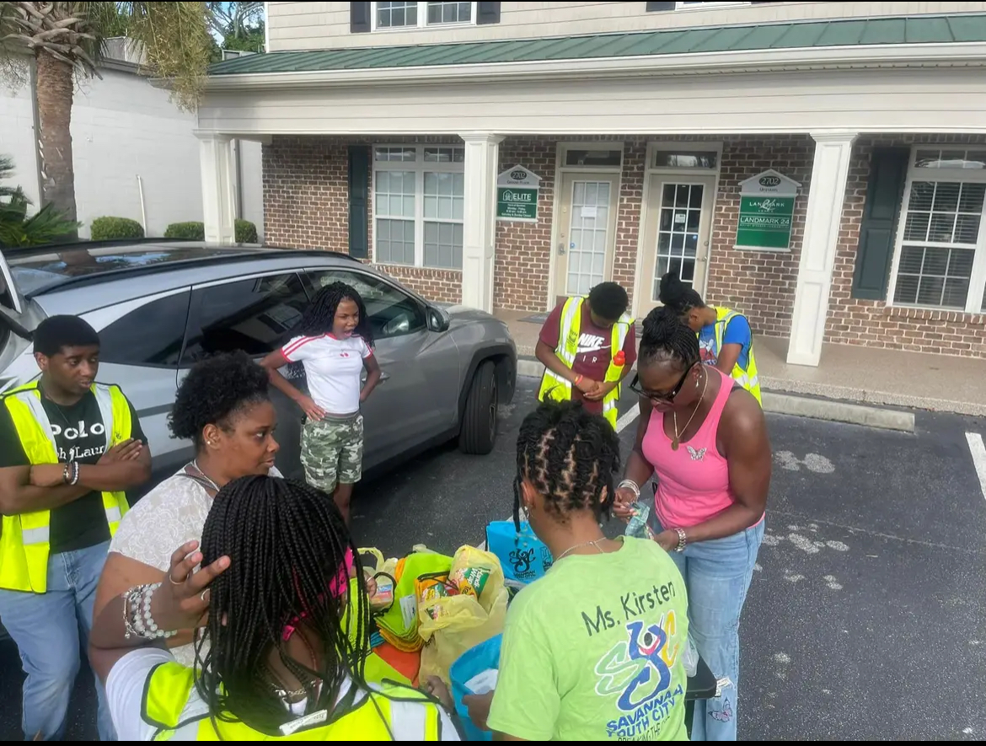
+375
+150
+30
Hurricane Bags Distributed
Surveys Conducted
Youth Participants

Slide 11
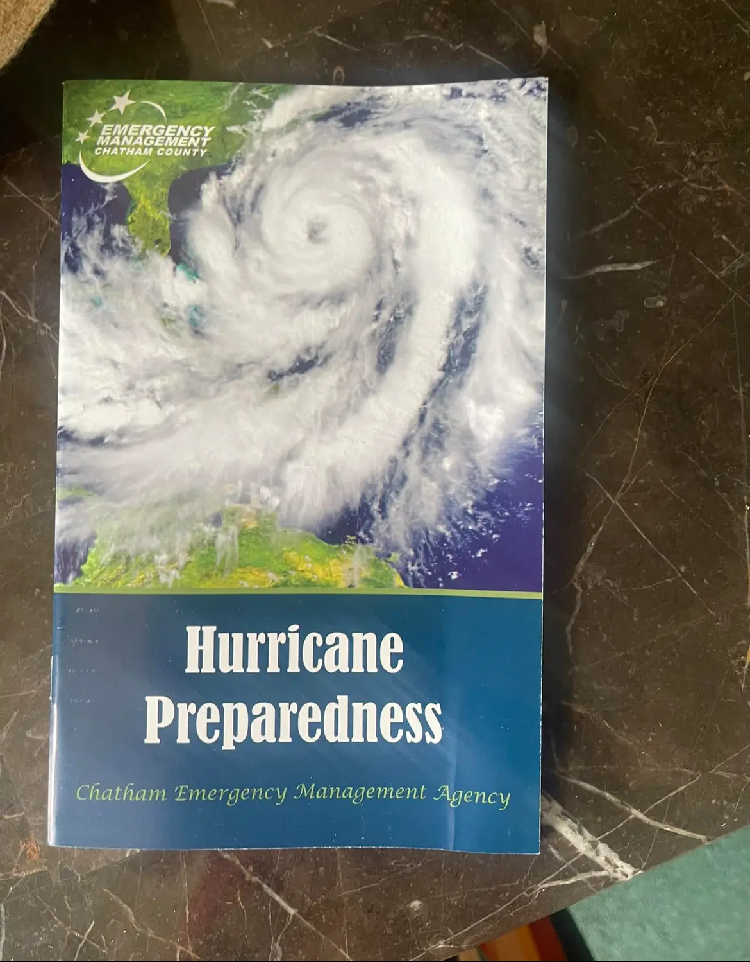
Education
Is
Key
Even if an office cannot afford to distribute hurricane preparedness bags, they can start with just pamphlets. We distributed 100s and even heard from residents after Hurricane Helene that they were incredibly helpful in a time of need.

Slide 12
+2000
Residents engaged by youth participants and volunteers

Slide 13
Surveys
80% of residents were not familiar with City of Savannah Office of Sustainability.
57% of residents engaged were already familiar with Savannah Youth City.
88% of residents do not believe Savannah is equipped to handle an intense hurricane or serious flooding event.
79% of residents engaged would like to be involved in Savannah Youth City’s Emergency Preparedness Program.
86% of residents provided personal information to be contacted in the future.
99% of residents felt that the information they received will help them in the future.
97% of residents would like for the City to invest more in hurricane preparedness and community resilience.

Slide 14
Lessons Learned
CONCLUSION 1:
In order for local governments to form deep connections with marginalized communities, it is essential that they work with CBO’s that have already gained trust from those populations.
CONCLUSION 2:
It is often more impactful to make hurricane preparedness and climate awareness empowering and hopeful instead of inducing climate anxiety.
CONCLUSION 3:
Local governments need to empower youth interested in fighting the climate crisis. This can help create the environmental leaders of tomorrow and can attract younger employees.

Slide 15
Videos From Project
Links :
https://www.facebook.com/share/v/pwjgFVSbXBH8Xan2/
https://www.facebook.com/share/r/1JEBWpsaFhptGsDb/
-https://www.facebook.com/share/r/dJYifgJoLbtSBUQa/
https://www.facebook.com/share/r/GN4ciMb1BWn8YJko/
https://www.facebook.com/reel/3809583999285797/
https://www.facebook.com/100066699940125/posts/822502859983038/
https://www.facebook.com/100066699940125/posts/819047373661920/
https://www.facebook.com/reel/508618074856733/

Slide 16
THANK You!
City of Savannah - Sustainability
Savannah, Georgia

