Slide 1
Cohort convening hosted at Xavier University discussing campus sustainability with local partners Last Mile Food Rescue and Hamilton County Resource

Slide 2
Cohort convening held at Last Mile Food Rescue

Slide 3
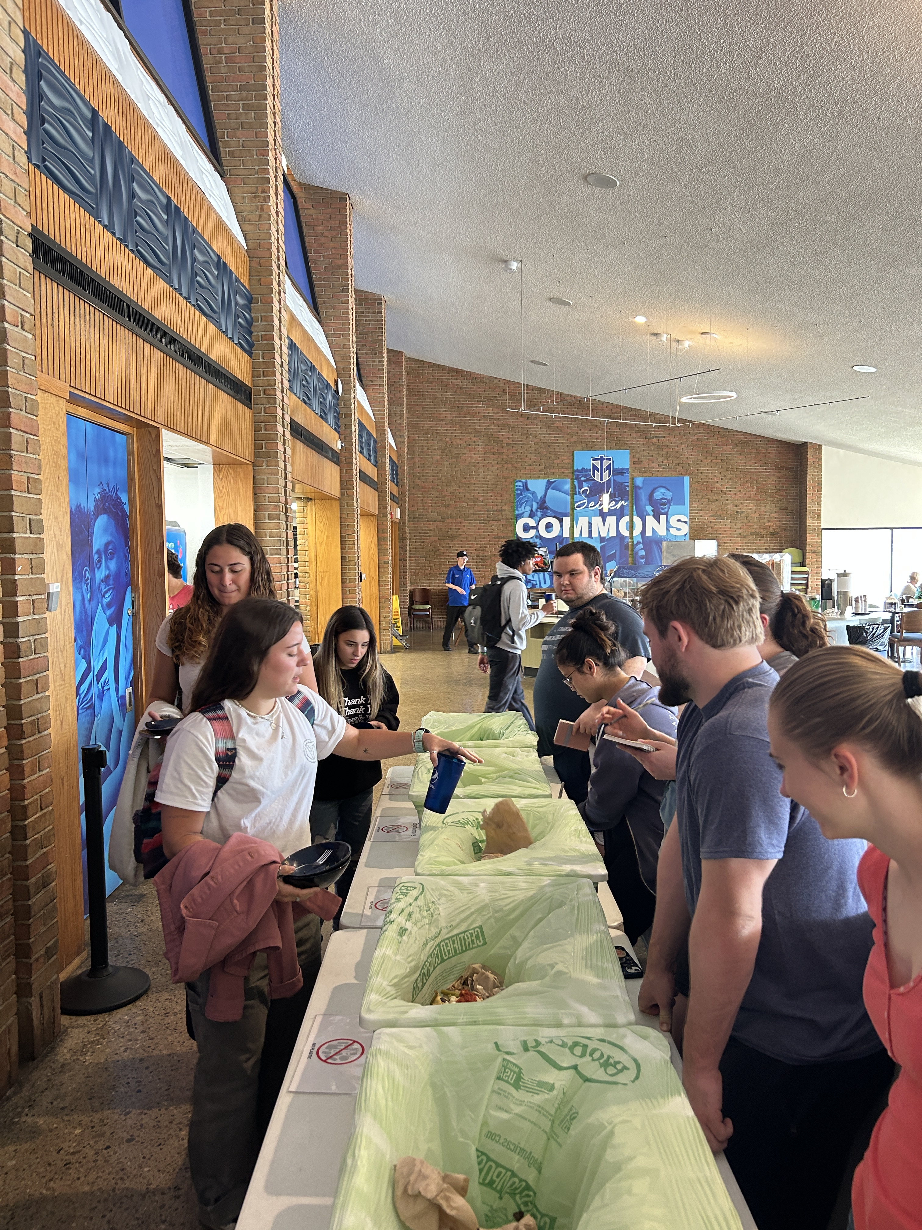
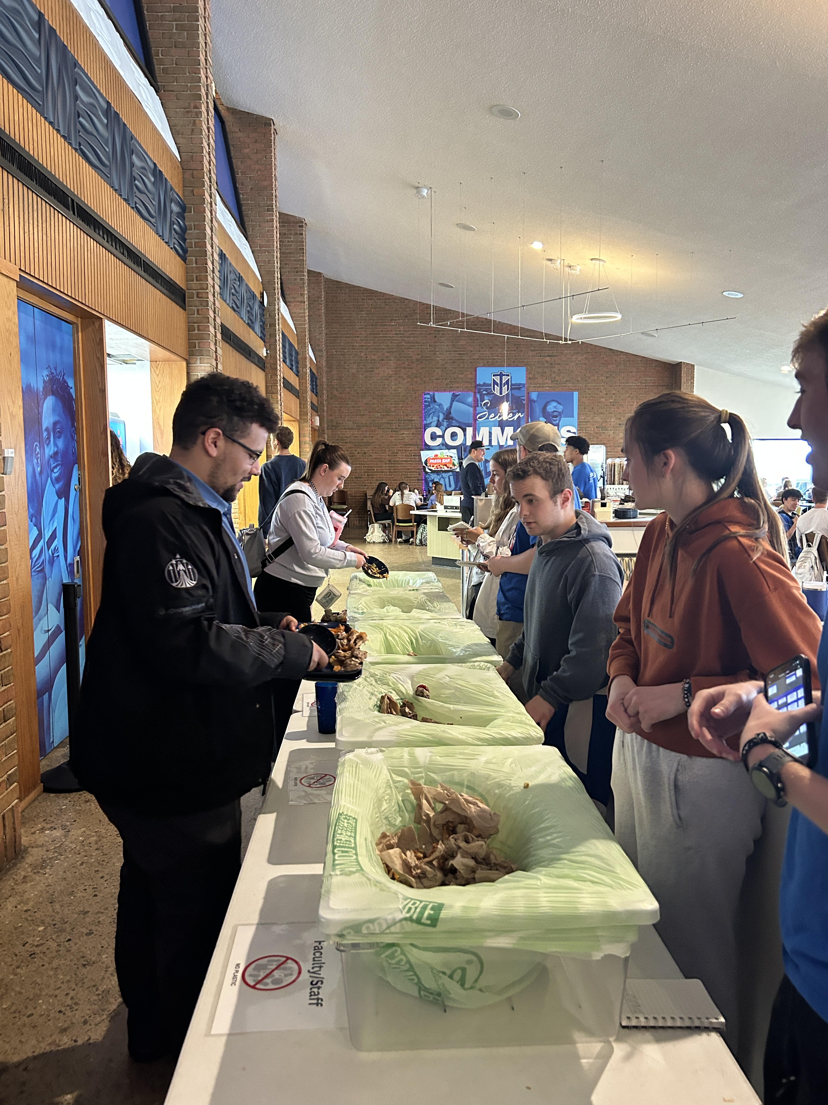
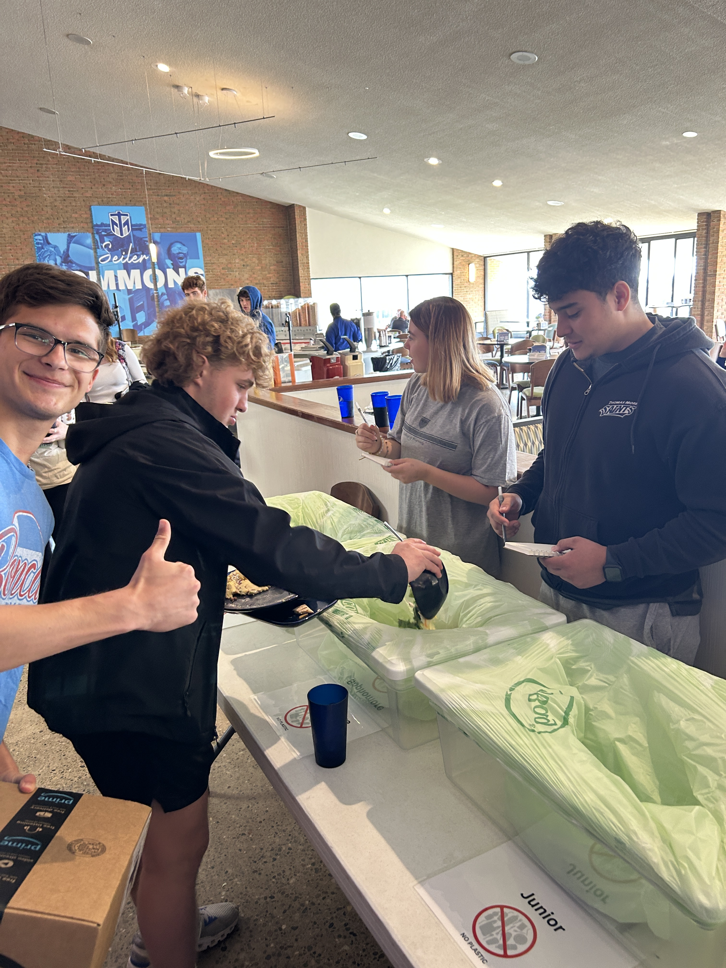
Students volunteering and participating in Weigh the Plate Initiative.

Slide 4
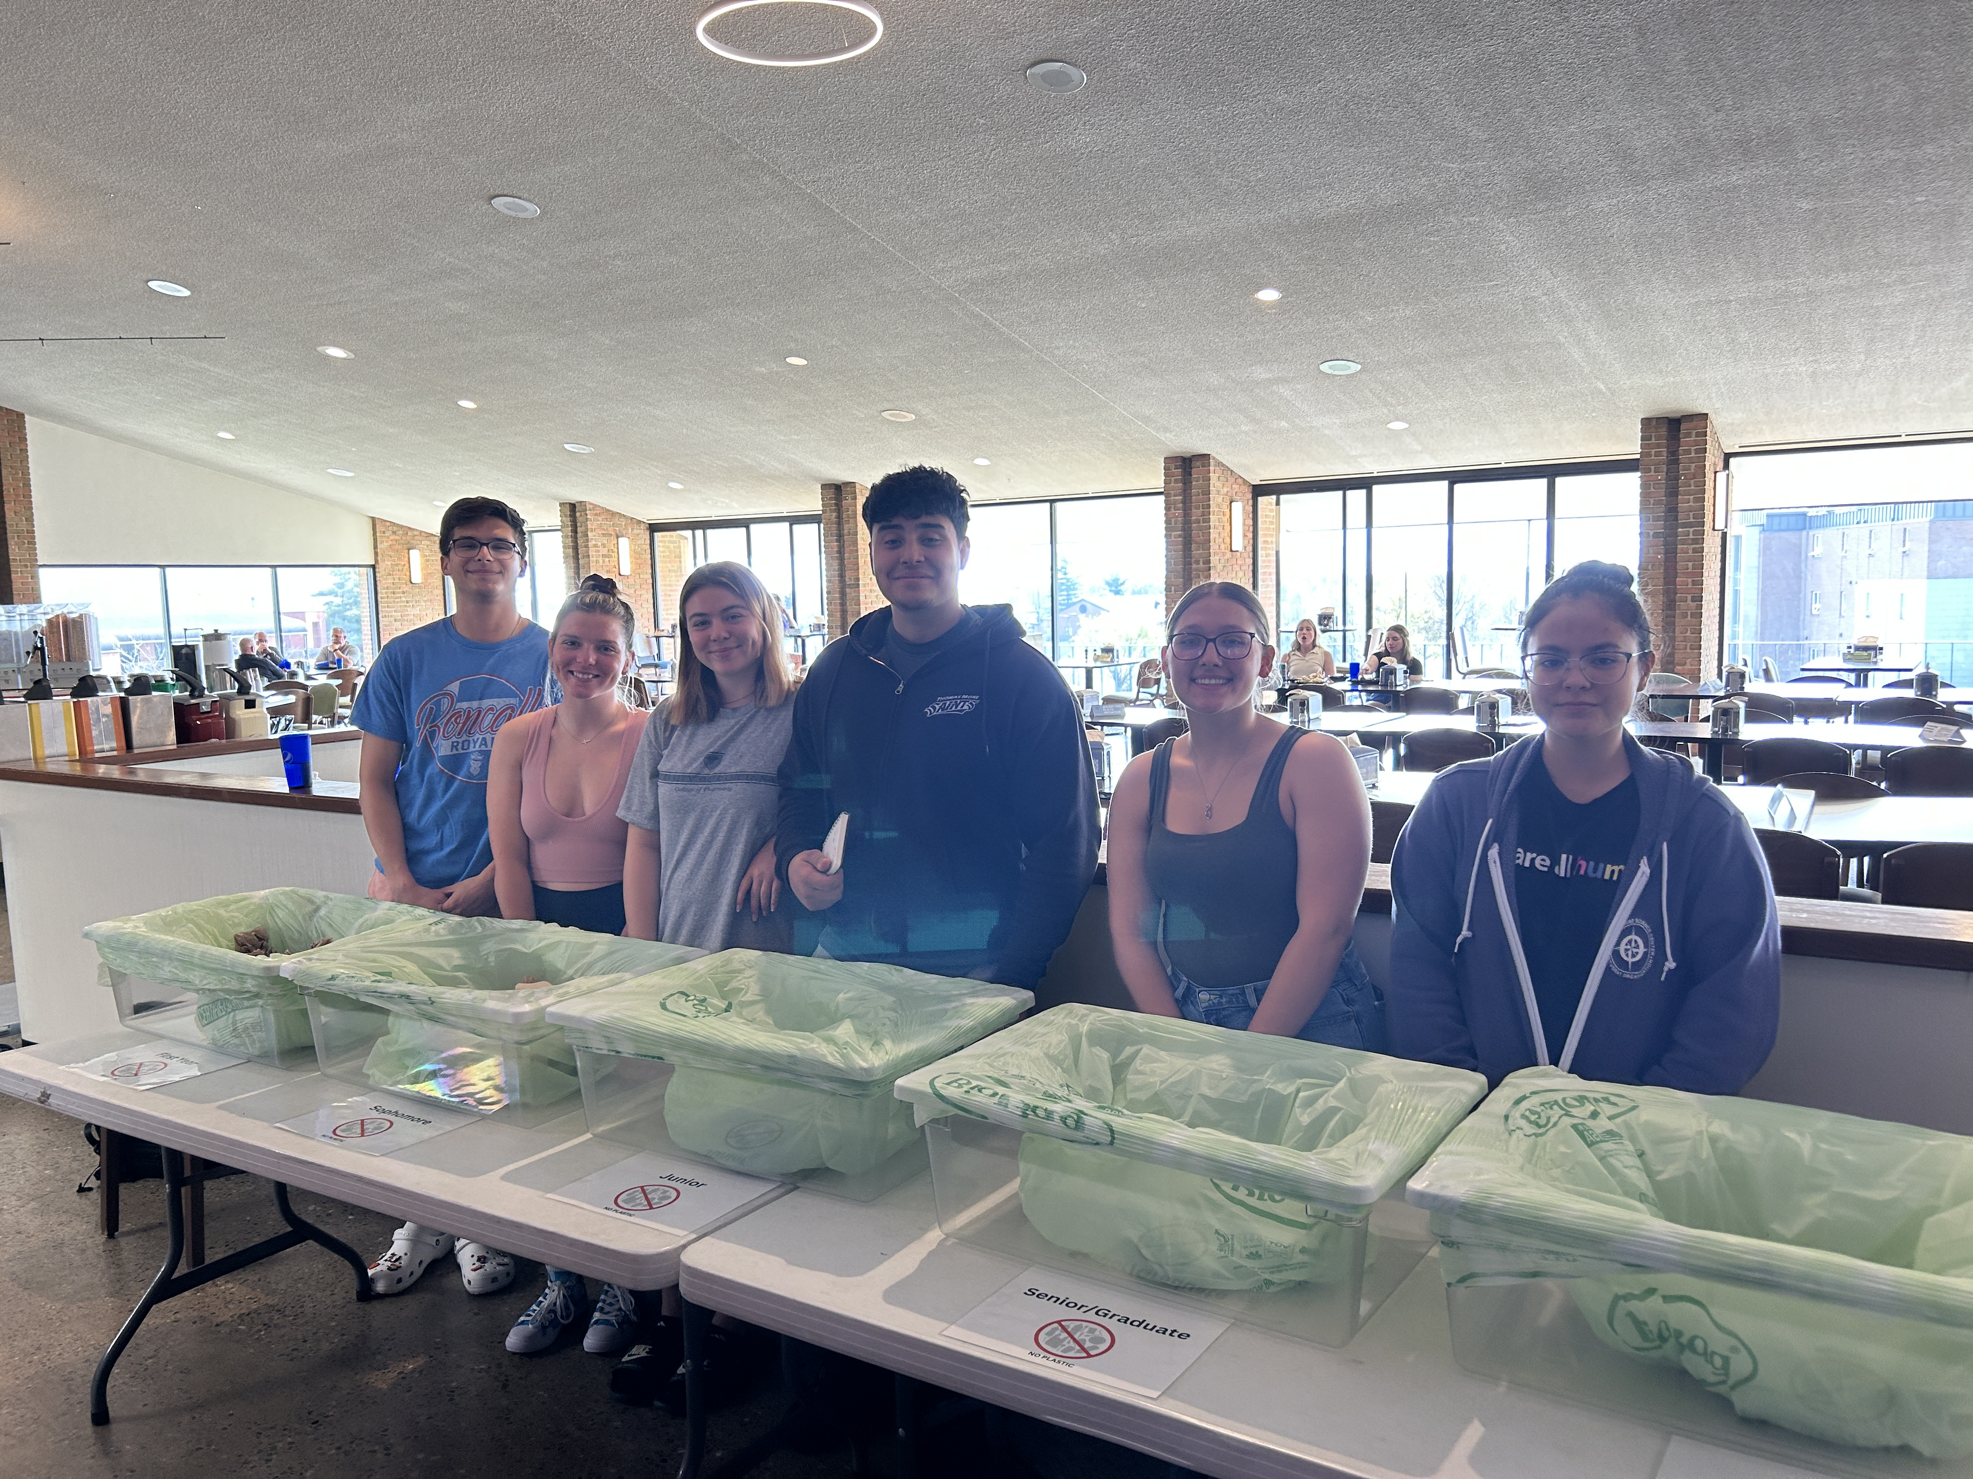
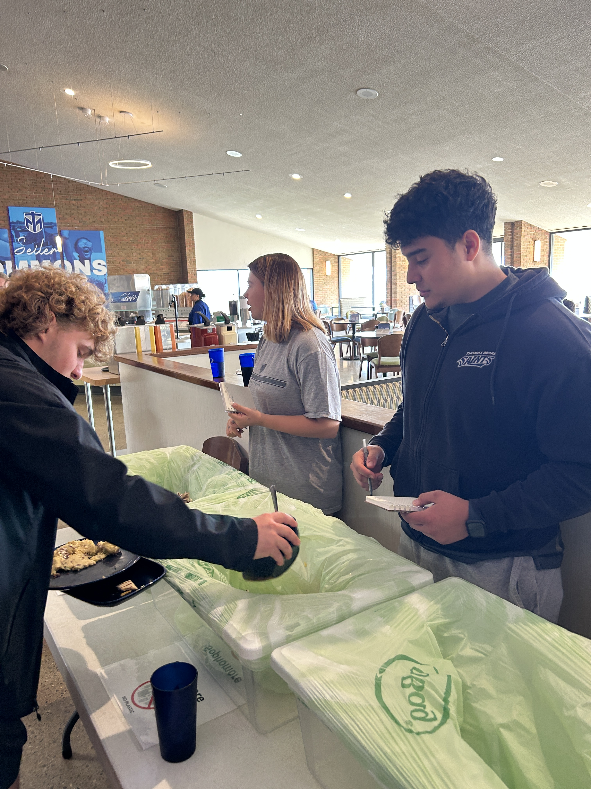
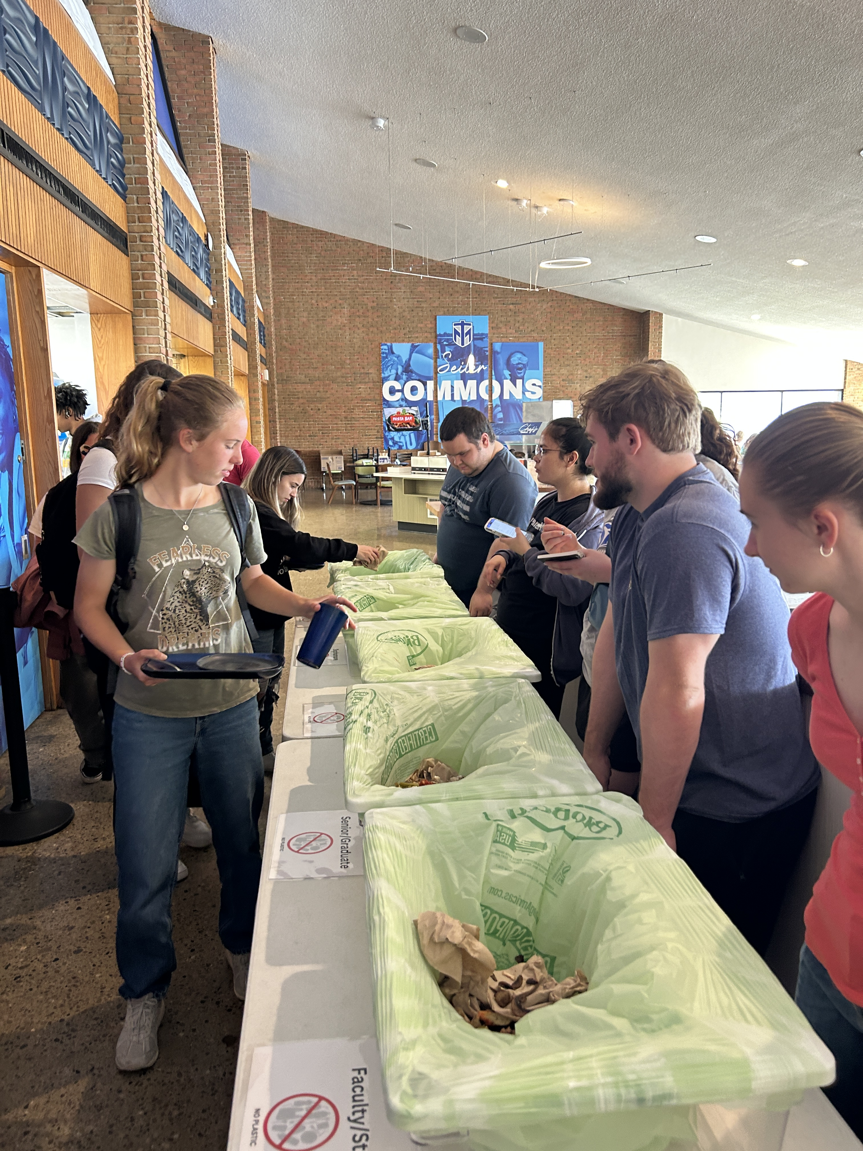
Summary Data from Weigh the Plate Project.

Slide 5
Education Signage created by cohort members to reduce food waste.

Slide 7
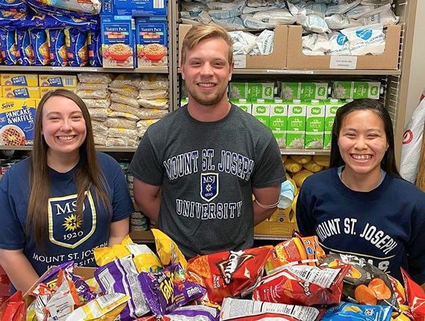

Slide 8
From the 5/3 Arena at University of Cincinnati to the Dining Hall at Northern Kentucky University, Last Mile Food Rescue rescued 25,258 pounds of food from Higher Ed Cohort Campuses. An additional 179 pounds was diverted from the landfill from the TMU Weigh the Plate project. So, from the initiation of the Higher Ed Cohort, approximately 25,437 pounds of food were diverted, and over 89,908 pounds of CO2 prevented at the landfill.

Slide 9
Campuses and Partners

Slide 11
Notes:
22 Million Pounds of food is thrown away every year due to campus waste

Slide 12
Notes:
This waste equals approximately 12 million pounds of CO2 Emissions

Slide 13
Notes:
Our friends at Move for Hunger survey yielded details on who experiences food insecurity- 38% of students enrolled in a two year college, and 29% at a 4 year college

Slide 14
Notes:
Bigger picture on our region- 270,000 folks in the Greater Cincinnati Region. One in 5.

Slide 15
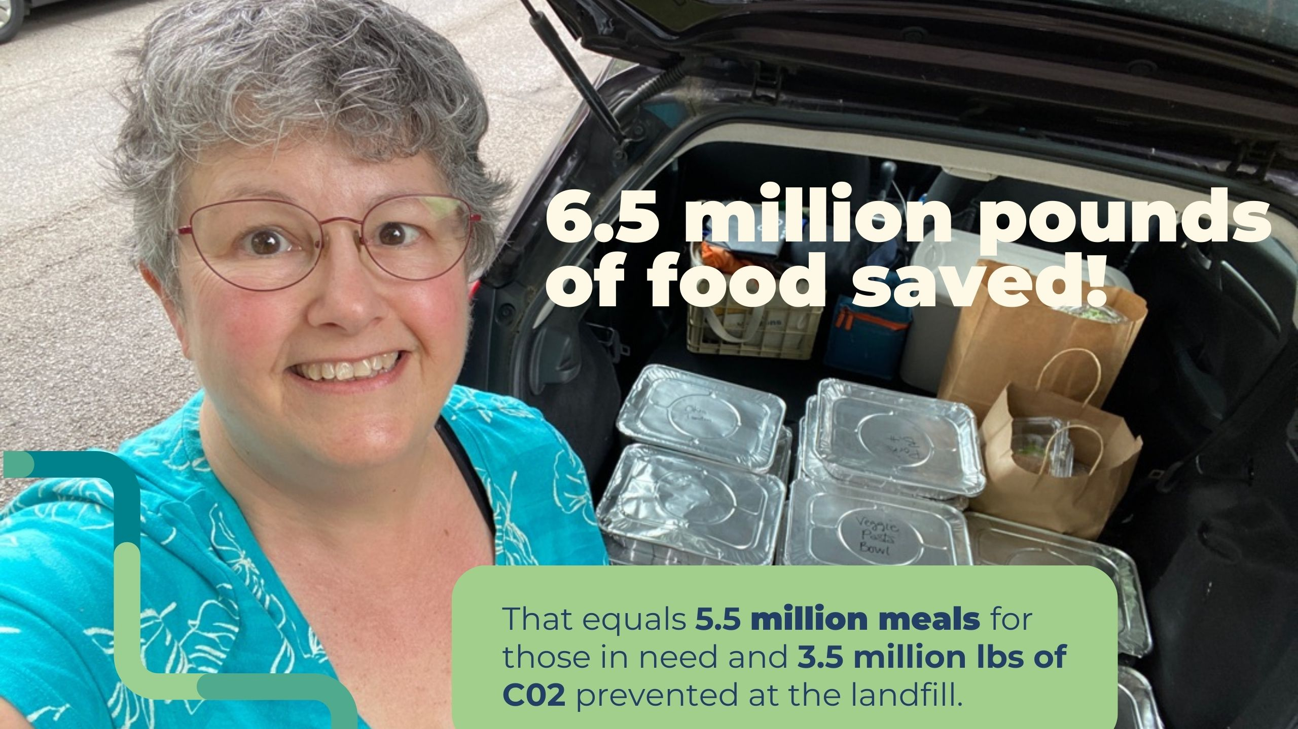
Notes:
Since our first rescue on 08/24/20

Slide 16
Notes:
NKU Chef Team and Food Donor Solicitor Erik, Prepared Trays from a corporate Campus, and Last Mile CoFounder Tom Fernandez with Chef Danielle at UC main campus

