Slide 1
Electrification in Homes and Apartment Buildings:
Presentation for HCD
______________________________________________________________________________________________________________
Shayna Hirshfield-Gold
Climate Program Manager
Office of the City Administrator

Slide 2
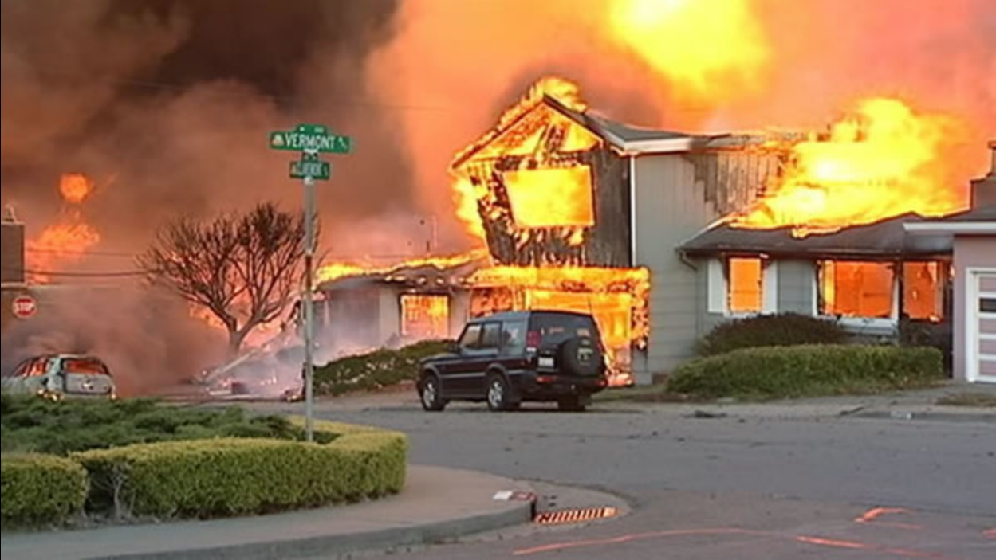
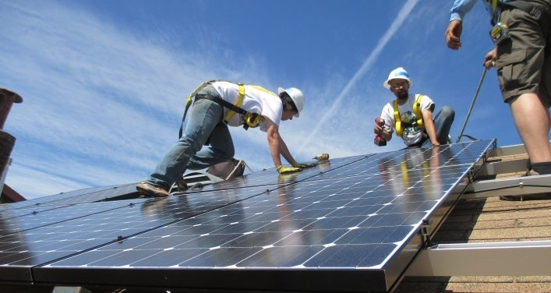
Why Building Electrification?
Health
Climate
Safety and Resilience
Jobs
Notes:
Also utility cost reductions
After disaster: 1 week to return electricity service, 6 months to return gas.

Slide 3
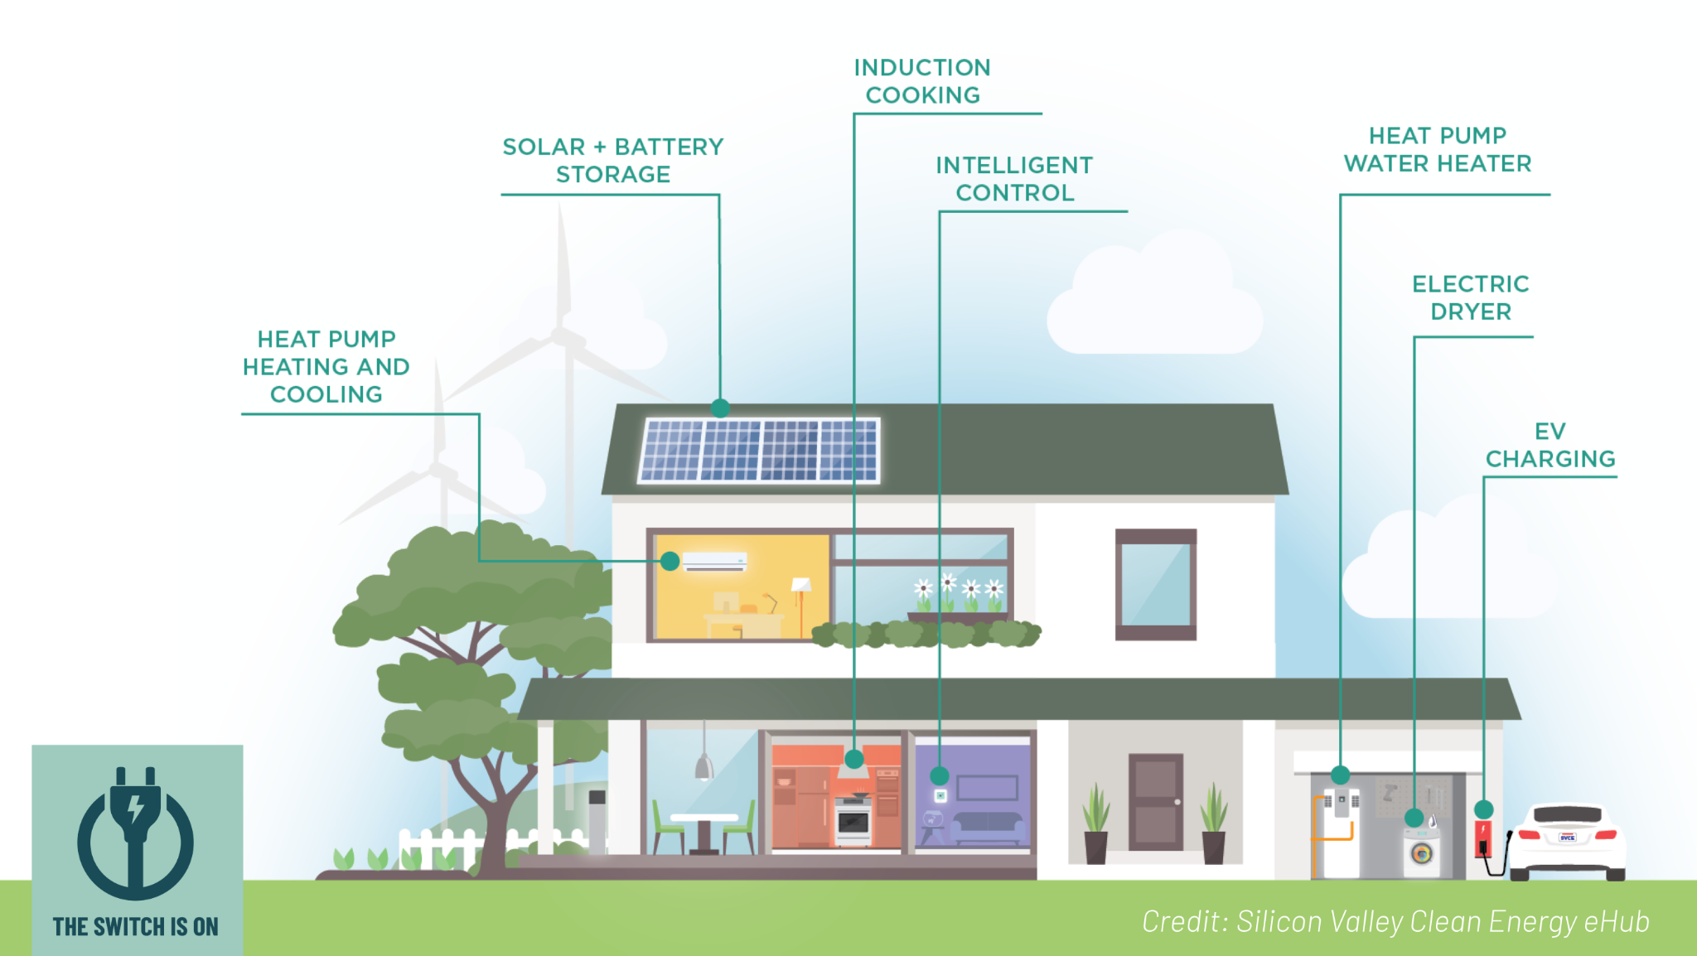
What is holistic electrification?
Gas appliances replaced with 100% electric &
Energy efficiency &
Improved air quality and comfort &
Lower environmental health risks &
Affordable & reliable energy
Notes:
In verbal, discuss the role of *clean* power – EBCE 100% renewable and C free by 2030. If you want to rework the penultimate bullet that I added, fine; I didn’t think “IAQ+comfort” covers all of mold, pest, + related issues, and thought it important to include. In verbal, make sure you address the many public $$ and programs to address these separate issues, but the barely-nascent awareness that they’re all connected to energy systems!
Transition homes over time to use only electricity instead of gas. Take advantage of money from government and utilities to make your upgrades. This helps you tackle climate change while making your air cleaner, reducing the risk of fires, improving your health, and lowering your energy bills.

Slide 4
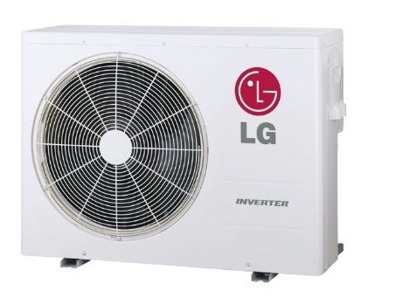
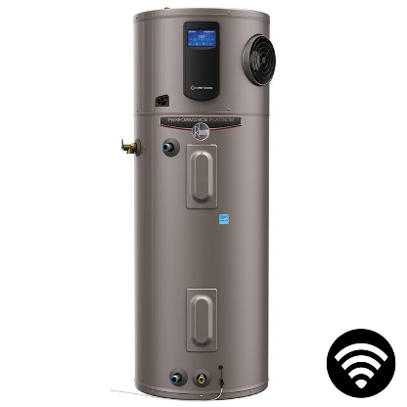
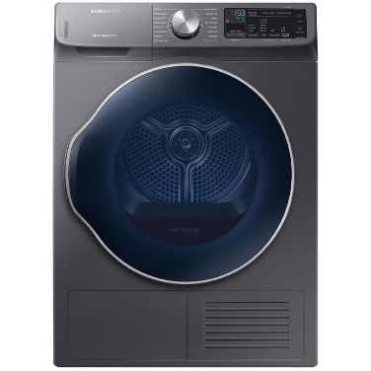
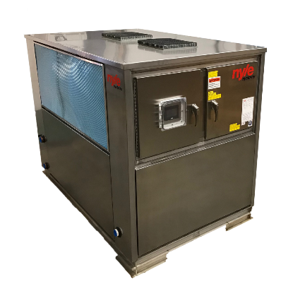
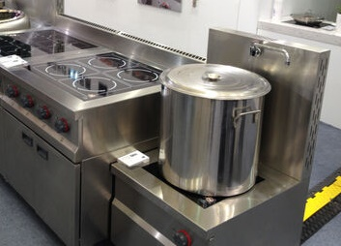
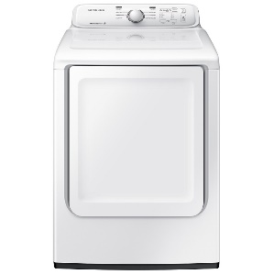
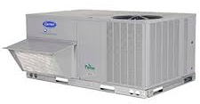
Examples of All-Electric Appliances
Space Heating
Water Heating
Cooking
Clothes Drying
Residential
Commercial
Notes:
Equipment technology, what options are available
Ex. Central AC and space heating for homes with existing ducts and one zone overall vs minisplits for homes that don’t have ducts and allow for multi-zone temperature control
Note verbally that replacing a gas furnace with an efficient heat pump is cheaper upfront than replacing an old gas furnace with a more efficient gas furnace plus installing a stand-alone AC unit.

Slide 5
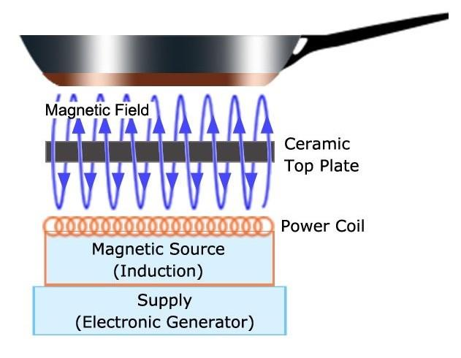
How does induction cooking work?
Electromagnetism heats cookware directly
Cookware must be able to carry a magnetic field (test with a magnet!)
Ceramic top stays cool
Notes:
This can be an interesting one to deliver. Your verbal needs to include, per paragraph:
…versus gas cooktops, which heat the air and pan, or electric, which heats the surface then pan. This nuance is lost on some.
Specify that stainless steel and cast iron work great.
Specify that burn risk is substantially reduced
Faster, more controllable, and more efficient than gas cooking.

Slide 6
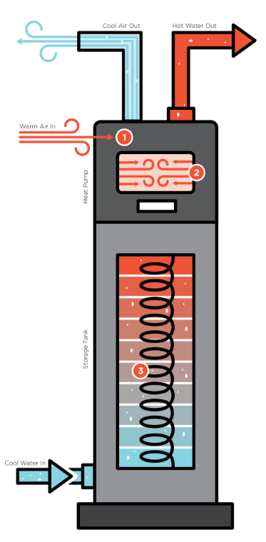
What is a heat pump?
Moves heat rather than creating it.
For space conditioning (heating + cooling) as well as water heating
Up to 3x more efficient than gas furnaces/water heaters
Cool Air Out
Hot Water Out
Warm Air In
Heat Pump
Storage Tank
Cool Water In

Slide 7
Next Steps
Major Opportunities
Clean grid… & getting cleaner!
Ava Clean Energy & BayREN supporting local efforts
Rebates & Incentives
Workforce development efforts
Electrification + Resilience
Notes:
EBCE: $17,500 of project costs to cover induction and electrical materials & equipment, 500 S+S, online cooking demos
BayREN: 300 for induction stoves, 1k for HPWH, 1K for insulation, 800 duct sealing, contractor training
Switch Is On

Slide 8
Oakland Building Electrification Timeline
December 2020
Ordinance for New Construction to be All-Electric Adopted
Nov. 2021
Community engagement launches
2040
All Buildings in Oakland are Fossil-Fuel Free
2024
Building Electrification Roadmap to Council
March-Dec. 2021
Electrification Workforce stakeholder series
3/10/2023
100 Local US Jurisdictions with Electrification Policies!
We are here!
Learn more: www.oaklandca.gov/projects/electrify

Slide 9
The Home Electrification Process
Understand your home
Plan your journey
Start electrifying
Self assess your home OR
Free consultation with Home Energy Score or Green House Call (Rising Sun Center for Opportunity)
Talk with your landlord about energy efficiency incentives available in Oakland
Explore SIO & Ava websites
Consider priorities & budget with Electrify Everything
Consult a Home Energy Advisor (866) 878 – 6008
Oakland’s Residential Lending program provides 0% loans & support for low-income homeowners
Check your eligibility for CARE/FERA, Spectrum, etc.
Maximize energy efficiency through DIY projects & available programs
Maximize rebates & tax credits with BayREN, California Energy Smart Home, and IRA
Find a qualifying contractor: www.switchison.org

Slide 10
Incentives and Rebates
California Low Income Weatherization Program: www.csd.ca.gov/Pages/Low-Income-Weatherization-Program.aspx
Rising Sun Center for Opportunity: risingsunopp.org/programs/ghc/
Grid Alternatives: gridalternatives.org/what-we-do/energy-for-all
Ava Community Energy: ebce.org/clean-power-appliances/
- Induction cooktop loaner- ebce.org/induction-cooking/
Notes:
LIWP California’s Low-Income Weatherization Program (LIWP) provides low-income households with solar photovoltaic (PV) systems and energy efficiency upgrades at no cost to residents.

Slide 11
Incentives and Rebates (cont.)
BayREN: https://www.bayren.org/rebates-financing/single-family-homeowners
California Energy-Smart Homes: https://www.caenergysmarthomes.com/alterations/
PG&E: https://guide.pge.com/
$1,000’s available for heat pumps, induction, electric dryers, insulation, & more! Stay up to date: incentives.switchison.org/. Track Federal rebates & tax credits: www.oaklandca.gov/topics/inflation-reduction-act-and-building-electrification

Slide 12
Questions?
______________________________________________________________________________________________________________
More info:
www.oaklandca.gov/projects/electrify
Ideas for Collaboration!
______________________________________________________________________________________________________________
RLS HEEP Pilot
Renter & Homeowner workshops
NOFO
Events…
\

Slide 13
Thank you!
______________________________________________________________________________________________________________
More info:
www.oaklandca.gov/projects/electrify

