Slide 1
OKI Regional Sustainability Director’s Network 2015 Annual Meeting --- Agenda Day 1
9:00: Coffee/Networking
10:00-10:10: Welcome; Opening Remarks
10:10-10:50: Introductions: The three things I want to have
conversations about are . . .
10:50-12:00: Urban Ag Session I: Overview of Innovation
Fund Products / Equity and Inclusion
12:00-1:00: Lunch/Networking
1:00-2:00: Urban Ag Session 2: Access to Healthy Food
2:00-3:00: Urban Ag Session 3: Ordinances and Zoning
3:00-3:30: Break
3:30-4:30: Site Tour: Gabriel’s Place
4:30: Adjourn – Hotel Check In
6:00: Dinner @ Taste of Belgium in Rookwood
7:30: Social Activity – Pilot Inn

Slide 2
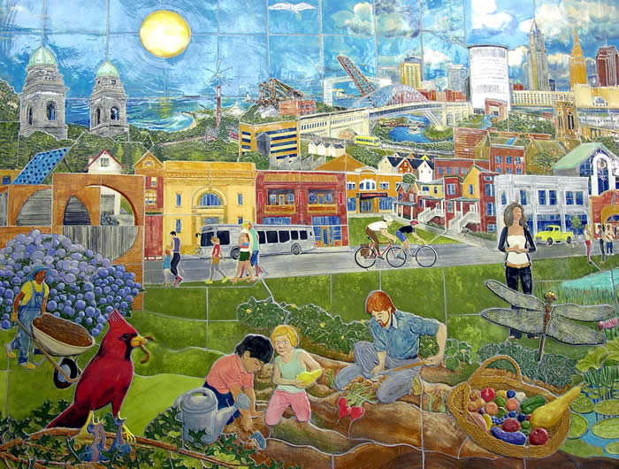
Urban Agriculture Best Practices
R. Alan Wight wightra@ucmail.uc.edu 11.5-6.15

Slide 3
Introduction
Facilitator Background:
Ecological Sustainability
Agricultural Experience
Agrifood Systems Research
USDN Innovation Fund Products: Urban Agriculture
Goals & Process

Slide 4
Innovation Product SCANs: Background
Urban Agriculture: Best Practices and Possibilities (2012)
29 USDN members, online survey, & 8 follow up f2f interviews
City Food Policy and Programs: Lessons Harvested from an Emerging Field (2012)
13 Cites, 15 interviews with USDN members
3. North American Food Sector, Part Two: Roadmap for City Food Sector Innovation & Investment (2013)
Literature review & developed a road map (how to guide) based on research

Slide 5
Four Areas: Outline
Equity & Inclusion
Access
Zoning & Ordinances
Food Policy Councils
Local Story (5)
Best practices, Solutions, and Approaches (20-25)
Regional Examples & Group Discussion (30+)

Slide 6
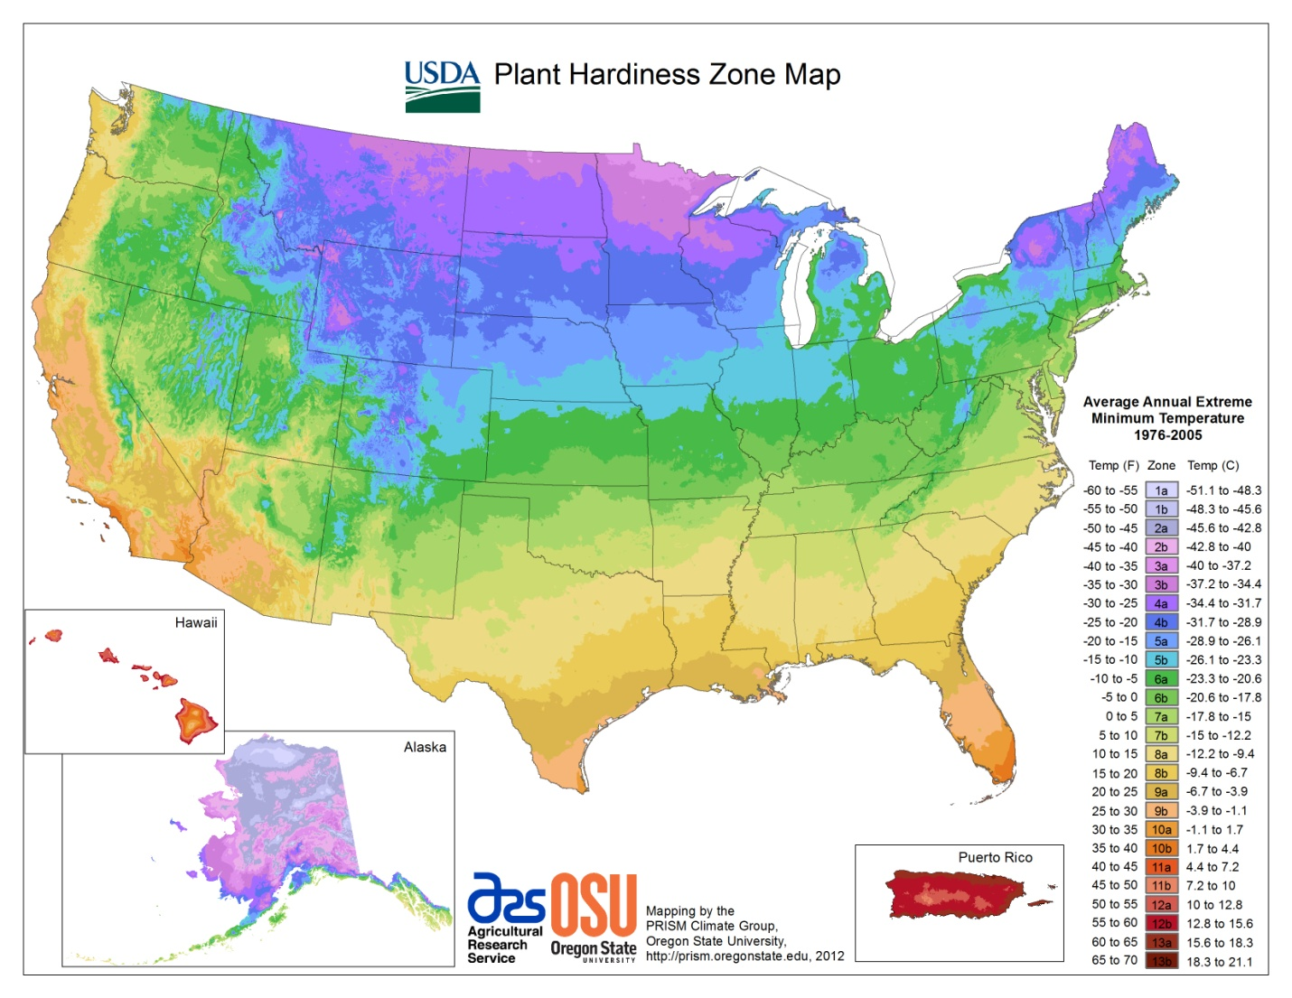

Slide 7
Urban Agriculture:
Is one component of local food systems, defined as, “the growing, processing, and distribution of food and other products through intensive plant cultivation and animal husbandry in and around cities.” (Bailkey & Nasr, 2000).
Scale
A Supply Chain Perspective

Slide 9
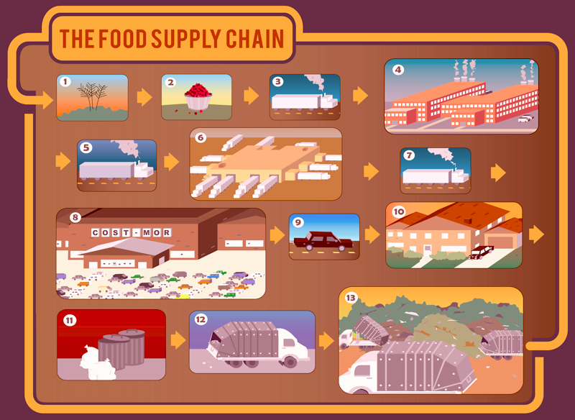

Slide 10
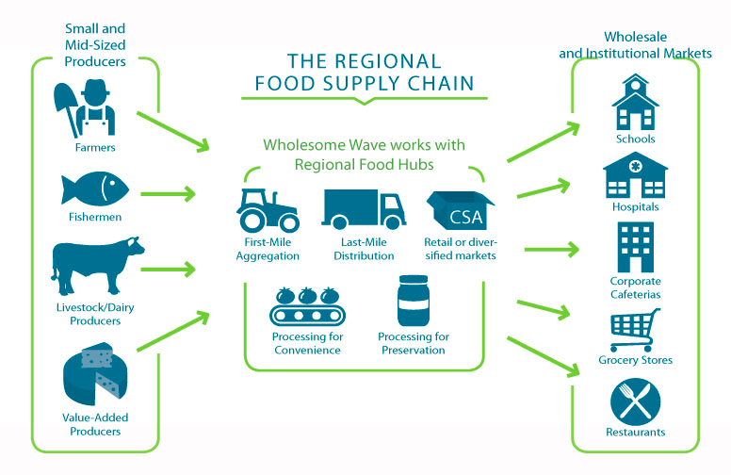

Slide 11
Common Forms of Urban Agriculture

Slide 13
Quick Discussion
Comments and Questions?

Slide 14
1. Equity and Inclusion
The Permaganic Story: Successes and Challenges

Slide 15
1. Equity & Inclusion: Process
Programs, Projects, & Policies
Diverse Citizen Involvement
Start where the people are...
- Their issues, concerns, & realities
Partnerships & Collaboration
- Mutual goals

Slide 16
1. Equity and Inclusion: Assets & Forms of Capital

Slide 17
Idea Flow

Slide 18
People Flow

Slide 19
Money & Land Flow

Slide 21
1. Equity & Inclusion: The Share Economy
Pick a Pepper (Columbia, MO)
Findlay’s Commercial Kitchen (Cincinnati)

Slide 22
1. Equity and Inclusion: Discussion
Examples:
Our Harvest Cooperative (Cincinnati)
500 Gardens (Cincinnati) – Dean
Mobile Kitchen & Cooking for the Family (Cincinnati)
Opportunity Gardens (Columbia, MO)
Gabriel’s Place – Trazana
Questions, Comments, & Challenges?

Slide 23
2. Access to Healthy Food
Food (In)Security, Deserts & Swamps
Availability
Accessibility
Affordability
Cultural and community
preferences

Slide 24
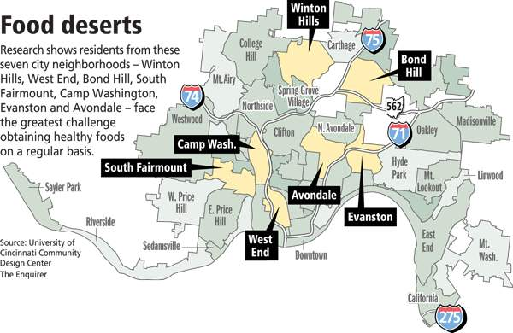
Story of Urban Greens and the East End…

Slide 25
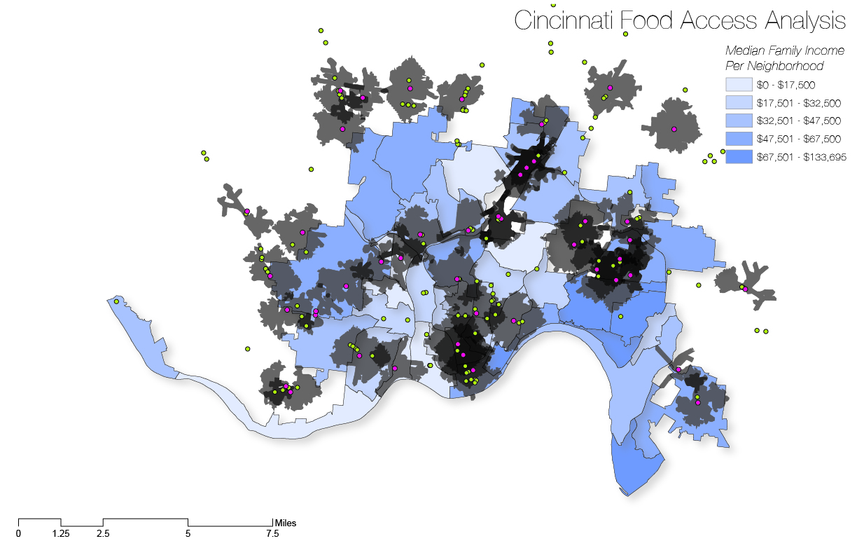
Deserts and Swamps:
Grocery Store & Fast Food Locations

Slide 26
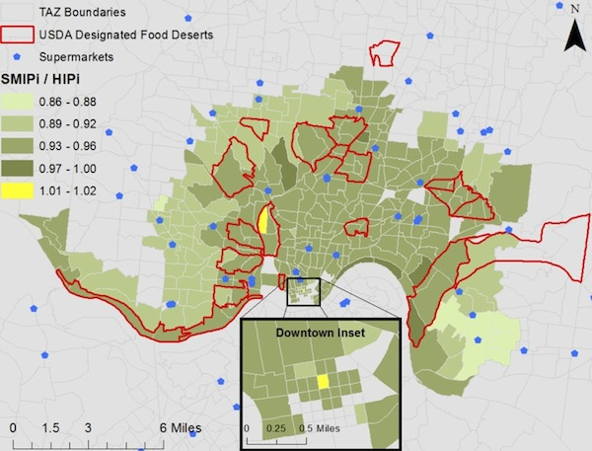
Transportation Analysis Zones
Supermarket Interaction Potential /
Home to Supermarket Interaction
Potential

Slide 27
2. Access Indicators & Metrics
Food Security Programs, Food Banks, etc.
Retailers selling local and/or healthy foods
Retailers accepting SNAP/EBT/WIC
$ or % of SNAP/EBT/WIC spent on healthy foods
Retail sq. ft. dedicated to local and/or healthy foods
Numbers of Gardens, Markets, CSAs, etc. & locations
Participants in local food campaigns

Slide 28
2. Access Best Practices & Solutions:
Smaller, more numerous grocery stores
Healthy Corner Stores (Bodegas)
Farmer’s Markets, CSAs, & other direct sale options
All Types of Gardens
SNAP participation (ex. Produce Perks)
Public transportation options
Delivery Services (ex. Green Bean)
Food System Participatory Planning
Education

Slide 29
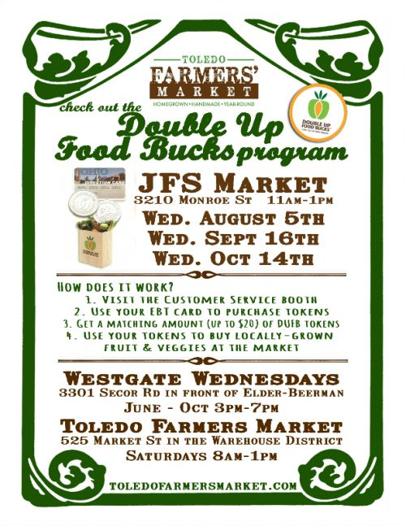
Double Up Food Bucks
Program of the Fair Food Network (MI based) ​
"...uniform design, central administration, and local implementation."​
Implemented by JFS & Toledo Farmers Market ​
Established in 2011 at 2 markets in Toledo, 2012 added LCJFS site​
​
Can be used at Toledo Farmers Markets (3) as well as MI markets (70+)

Slide 30
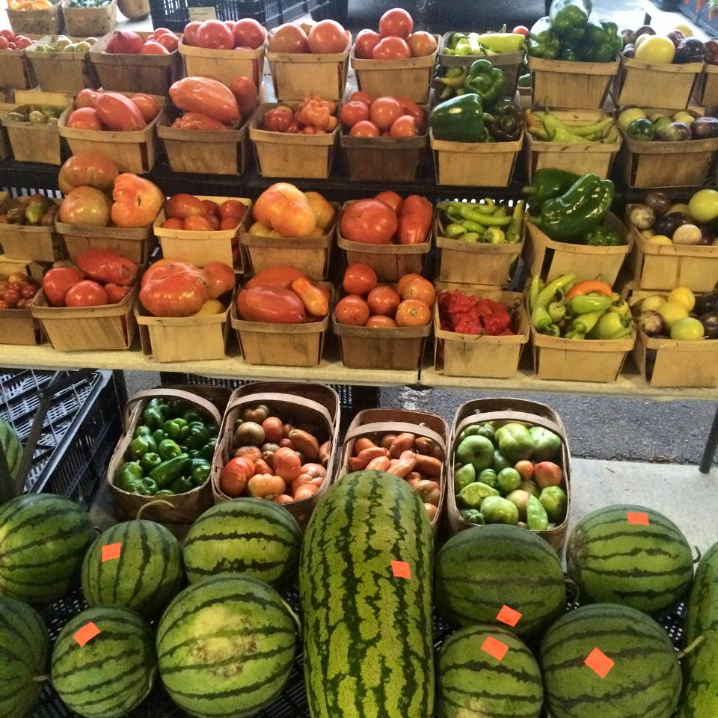
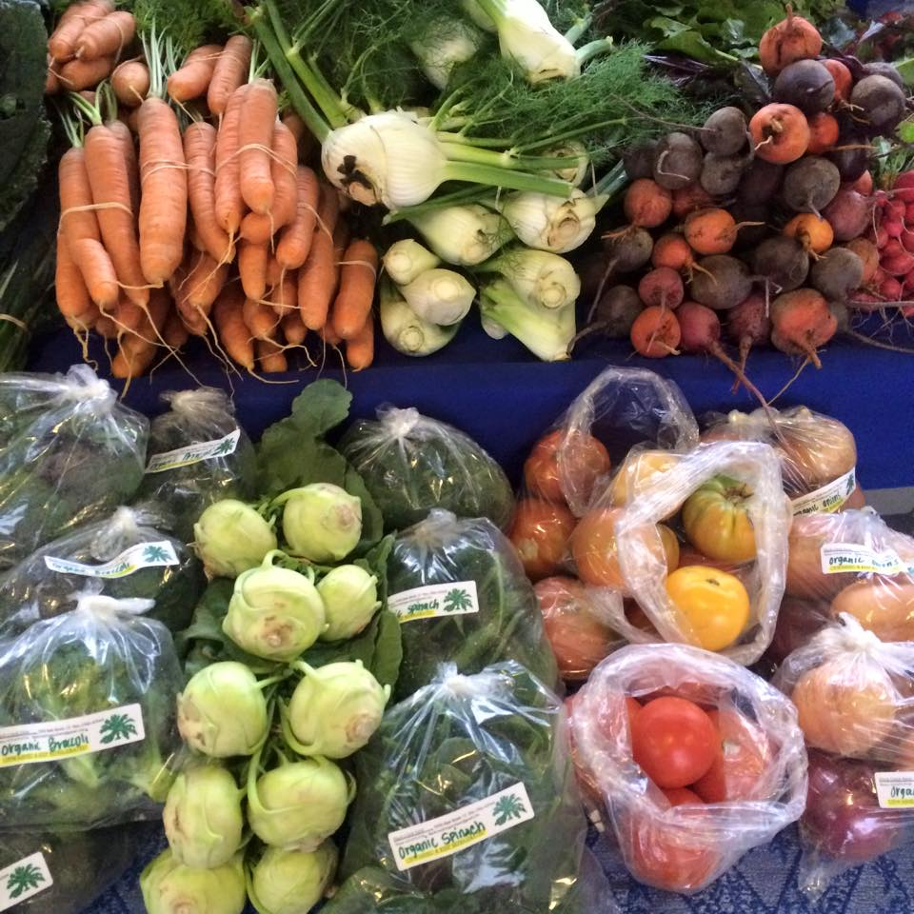
Matches SNAP $ for $ up to $20 for use only on fruits & veggies​
Funding from private foundations in NW Ohio​
ProMedica, United Way of Greater Toledo, Toledo Community Foundation
SNAP sales increased from $91.2K to $201K from 2010 to 2012 for OH​
$1.5K to $50K from 2007 to 2011 for Toledo

Slide 31
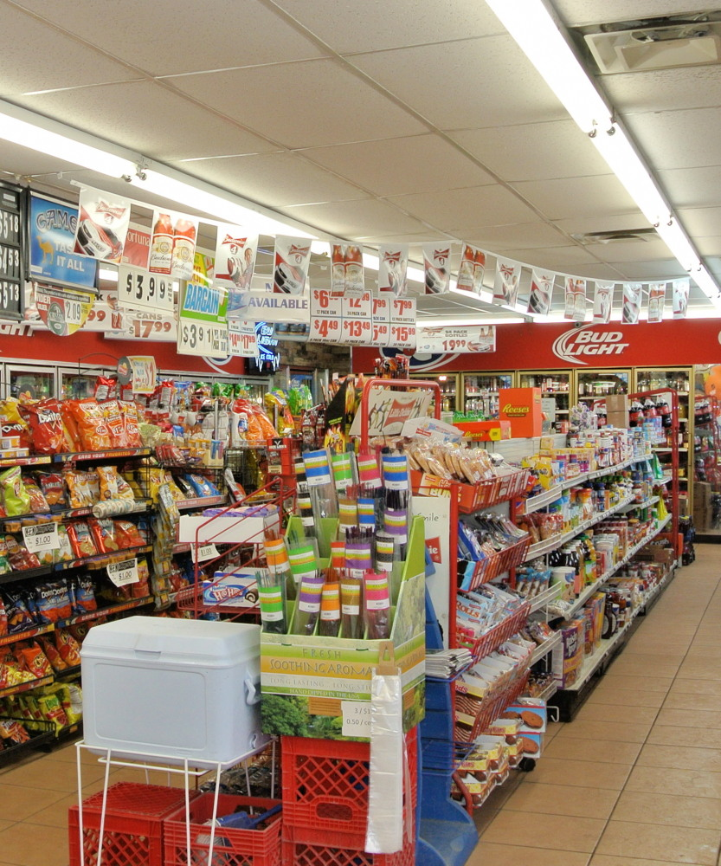
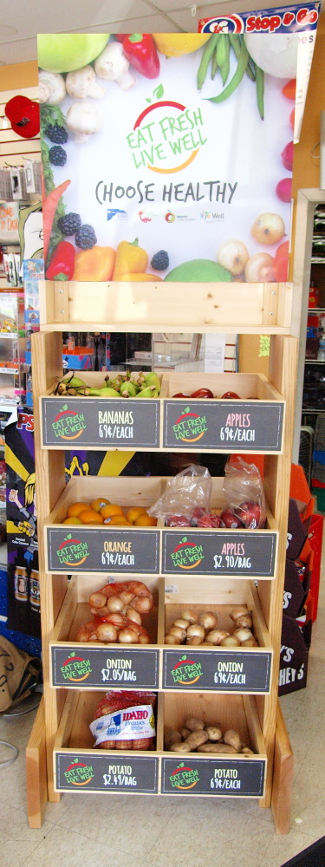
Program Goals

Slide 32
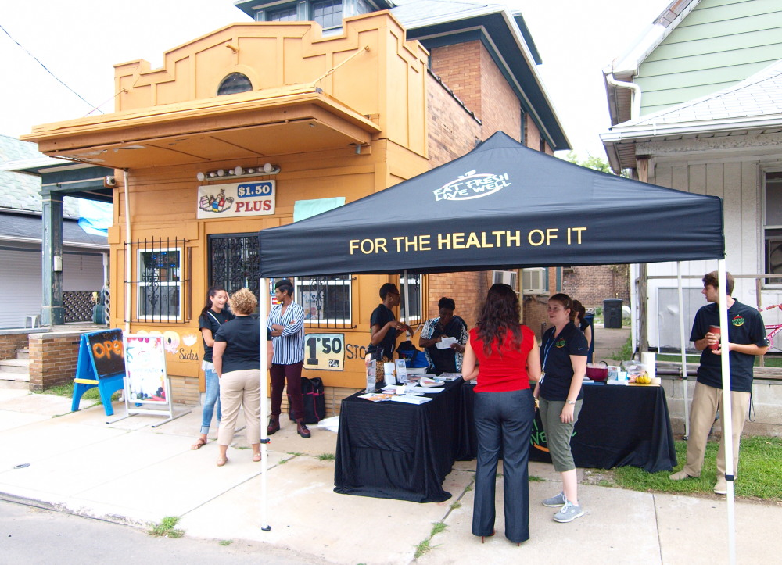
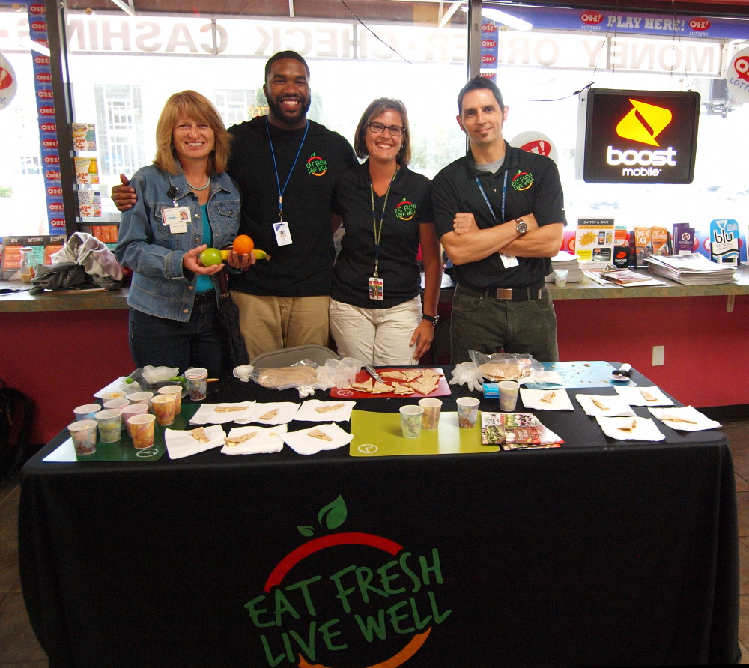
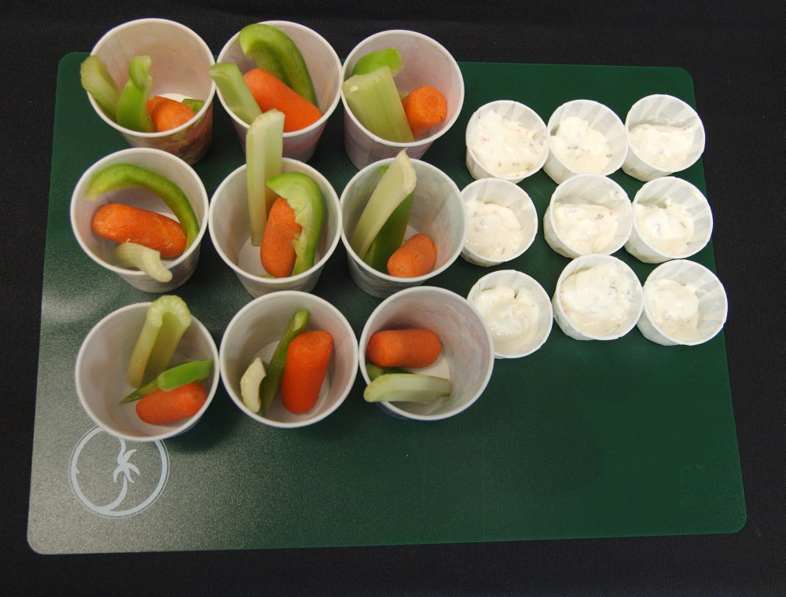
Kick-off Events

Slide 33
2. Healthy Food Access Discussion
Regional Examples:
Melissa with Healthy Corner Store Initiatives
Questions & Comments
Will these practices increase healthy eating?

Slide 34
3. City Ordinances and Zoning Regulations
For health, safety, economic (property value, aesthetics), and land management reasons.
These laws and codes are some of the major obstacles and solutions to increasing UA efforts.
Successful UA goals and programs are incorporated into a cities comprehensive land use plan.

Slide 35
3. Ordinances & Zoning: College Hill
Bahr Farm – Our Harvest Coop
Production Site

Slide 36
3. Ordinances and Zoning
Major barriers to developing programs & projects:
Health Codes
Zoning
City Ordnances
Access to water
Access to capital
Homeowners Associations Restrictions
Contamination/Brownfield sites & Redevelopment

Slide 38
3. Ordinances and Zoning Best Practices
Land disposition
Policies and regulations for UG infrastructure
Adopt UG friendly ordinances for private lands
Use of public lands
Public engagement and education
Political leadership
Create a “One Stop” for food businesses permits

Slide 39
3. Ordinances and Zoning Discussion:
Regional Examples: Larry
Ordinance 2012-00908: Mobile Vending
Ordinance 2010-00098: Primary & Ancillary Gardening
Minneapolis Staple Food Ordinance, T. 10, C. 203:
Ensures that grocery stores provide a minimum selection of healthy food options.
Questions, Comments, & Challenges?

Slide 40
Agenda Day 2:
8:15: Breakfast
8:45-9:45: Urban Ag Session 4: Food Policy Councils
9:45-10:30: Urban Ag: Identify urban ag best practices members can
do in their own communities; Dissemination Plans to
other OKI USDN members; other OKI cities/jurisdictions
and Midwest Regional Sustainability Summit June 2016
10:30-11:00: Break
11:00-12:30: USDN Pilot Project/OKI Business Meeting
Urban Ag Break Out Session
12:30-1:30: Lunch
1:30-2:30: Small Discussions
a. Funding a Sustainability Program
b. Climate Adaptation Efforts
2:30-3:00 Closing Session – next steps
3:00-4:00 Optional: Open Discussion

Slide 41
4. Food Policy Councils
FPC – provide a place to discuss and plan a city’s or regions food system and changes to these systems.
Brings together stakeholders from diverse food related sectors to develop policy recommendations.
Examples of Stakeholders and Partners…

Slide 42
4. Top Issues that Food Policy Councils Address

Slide 44
4. Factors Promoting FPCs

Slide 45
4. Bureaucratic Locations of FPC

Slide 46
4. Toronto: Governance & FPC

Slide 47
4. LA: Governance & FPC

Slide 48
4. FPC Best Practices
Determine FPC goals and priorities
Locate FPC within municipal government
Close to the mayors office
In a location that promotes cross agency collaboration
Start with and use existing metrics
Take advantage of all funding sources

Slide 49
4. FPC Metrics

Slide 50
Food Policy Councils Discussion
Regional Example – Angie Carl & David H.
Questions & Comments?

Slide 51
5. Next Steps & Dissemination Plans
Implementation by OKI Members
Electronic Dissemination
Midwest Regional Sustainability Summit
& Other Events

Slide 52
Bonus Slides for Additional References
Food
Hub
Graphic

Slide 53
Human Assets & Capital Metrics

Slide 54
Financial Assets & Capital Metrics

Slide 55
Social Assets & Capital Metrics

Slide 56
Physical Assets & Capital Metrics

Slide 57
Natural Assets & Capital Metrics

Slide 58
Minneapolis Ordinance 10(203)

Slide 59
Minneapolis Ordinance 10(203)

Slide 60
Recommendations for UA Policies

Slide 61
Suggested Municipal Policies
Enact institutional purchasing policies
Play an organizing role for these local purchasing policies with schools, colleges, senior centers, hospitals, etc.
Adopt mobile foodservice and retail to increase access to healthy foods
Help start FPC

Slide 62
Suggested Municipal Policies
Establish Online Aggregation of Small Producers
This is a “many” to “few” model.
Requires large amount of small, qualified producers
Facilitate micro-lending and slow money models for loans and investment
Locate Food Hubs and other smaller food businesses near by incubators and prep kitchens

Slide 63
FPC Areas of Focus - Examples

